Slide 1
I Know Where You’ve Been: Geo-Inference Attacks via the Browser Cache
Yaoqi Jia∗, Xinshu Dong†, Zhenkai Liang∗, Prateek Saxena∗
∗School of Computing, National University of Singapore
†Advanced Digital Sciences Center

Slide 2
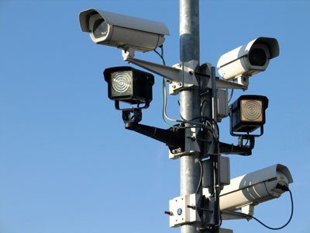
Geo-location in Browsers
Benefits
Threats
1

Slide 3
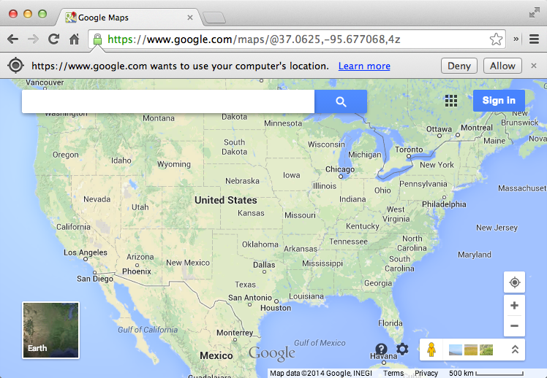
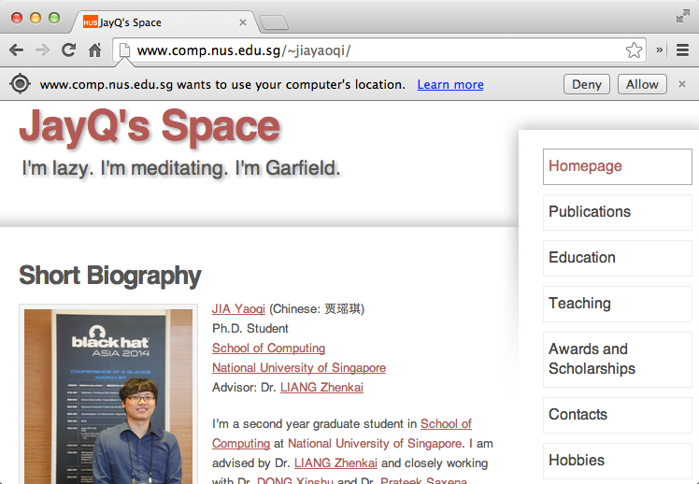
May I Access Your Geo-location?

Slide 4
Sources of Users’ Geo-locations
Browser
Not reliable

Slide 5
Problem Statement
?
Browser
Can the attacker infer the user’s geo-location from his browser?

Slide 6
Our Contributions
Geo-inference attacks via the browser cache
Infer a user’s country, city or even neighborhood
Prevalence of geo-inference attacks
Five mainstream browsers and even TorBrowser
55 top Alexa and 11 map service websites
Pros & cons of potential solutions

Slide 7
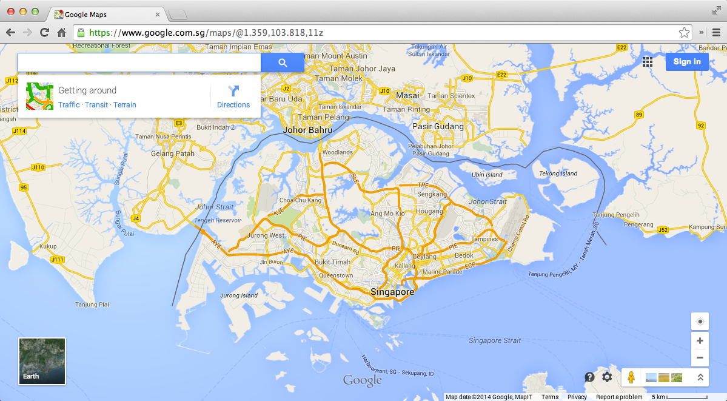
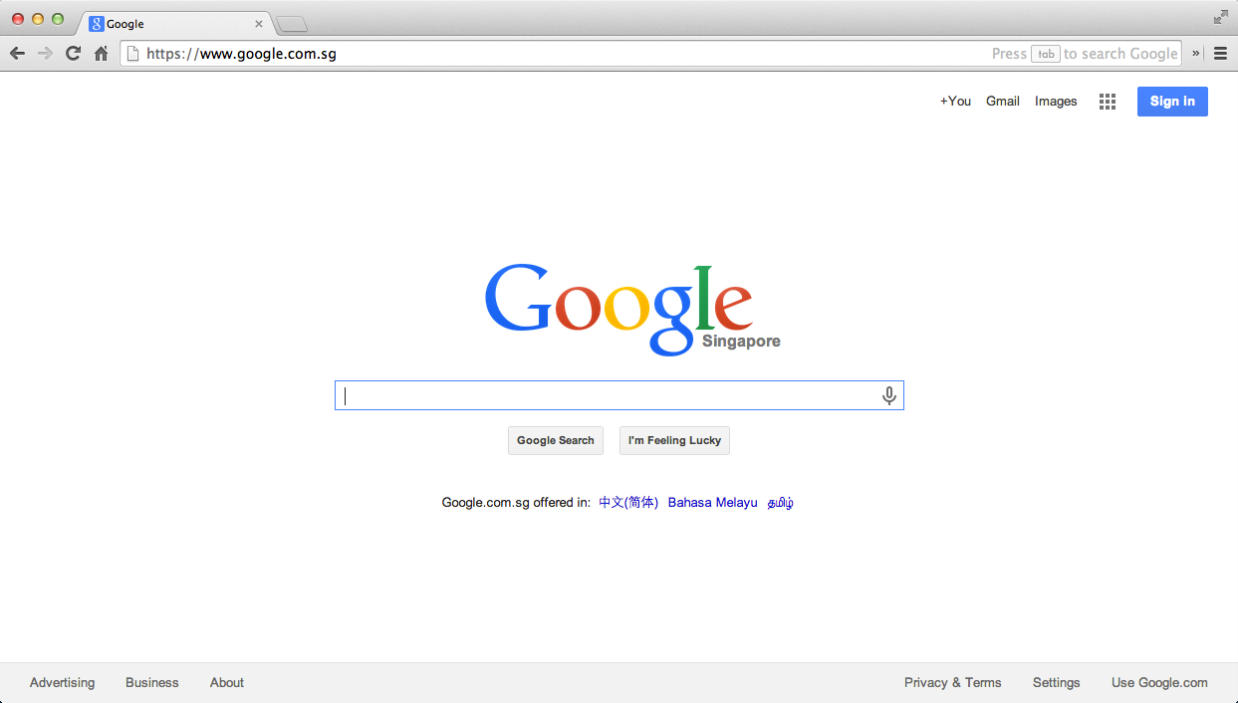
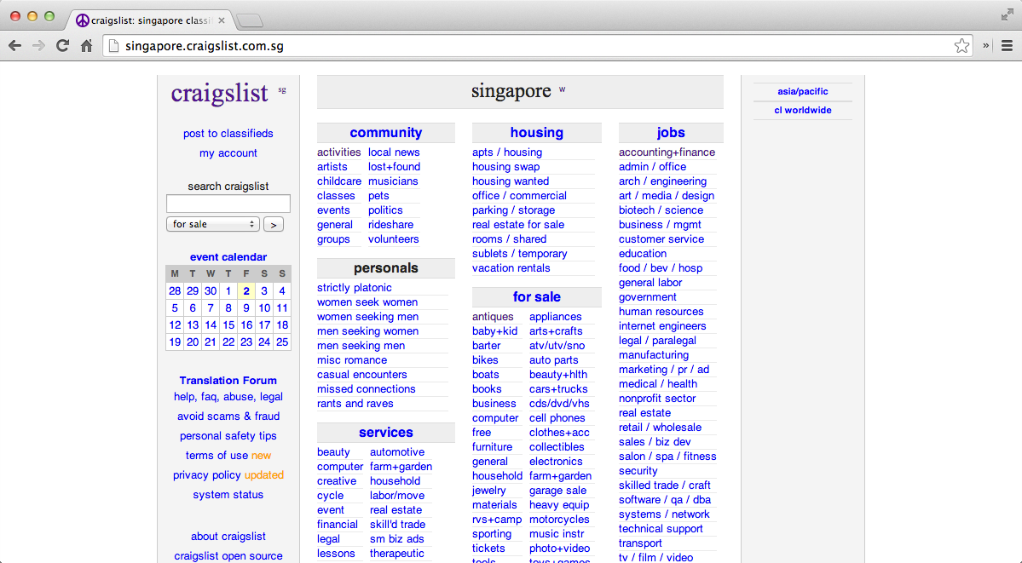
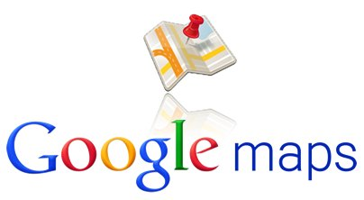
Timing Channels via the Browser Cache (I)
Browser stores
site-related states
Browser

Slide 8
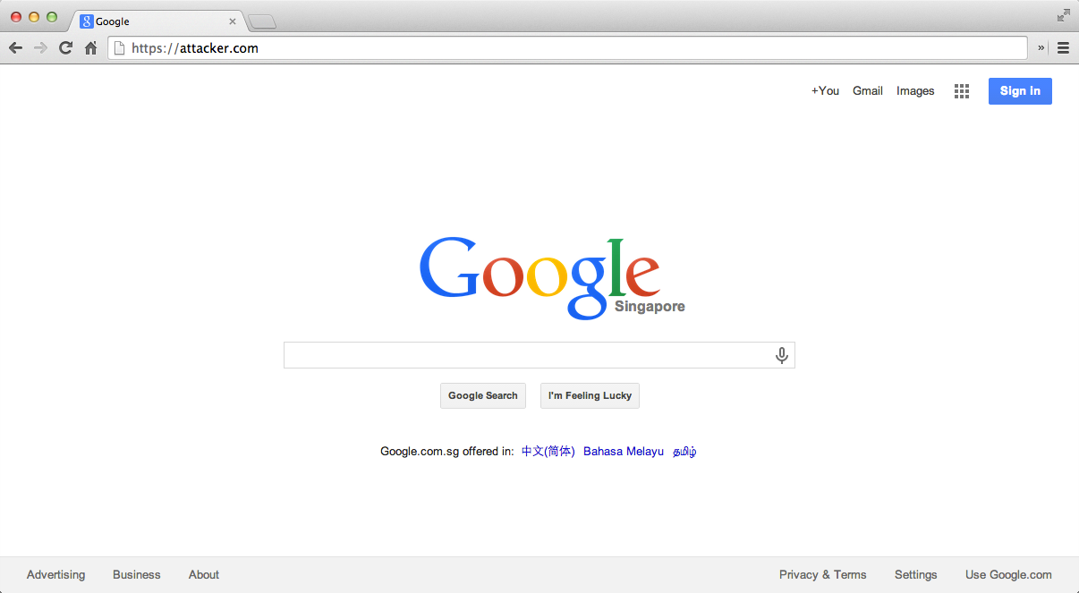
Timing Channels via the Browser Cache (II)
Felten, CCS’00,
Sniff browsing
history
1st: 1360ms
2nd: 320ms
3rd: 350ms
Bortz, WWW’07,
More Scenarios
Browser Cache

Slide 9
Geo-Inference Attacks via the Browser Cache
Browser cache
is shared
across all sites
Infer users’
geo-locations!
Browser Cache

Slide 10
Examples: What Can We Achieve?
User’s country?
User’s city?
User’s neighborhood?

Slide 11
How to Infer a User’s Country?
Google has 191 regional sites.
One site represents one country or region.
google.com.sg/images/srpr/logo11w.png
10

Slide 12
Attack Vector (I) : Measuring Image Load Time
Before Loading
img.onload Fires
var image = document.createElement(`img');
image.setAttribute(`startTime', (new Date().getTime()));
image.onload = function()
{
var endTime = new Date().getTime();
var loadTime = endTime - parseInt(this.getAttribute(`startTime'));
......
}
attacker.com
11

Slide 13
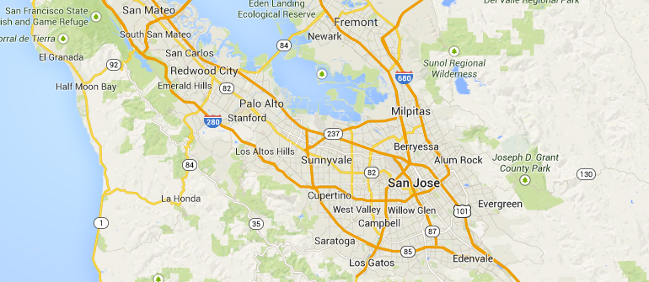
How to Infer a User’s City?
Craigslist has 712 city-specific sites.

Slide 14
Attack Vector (II) : Measuring Page Load Time
Before Loading
iframe.onload Fires
var page = document.createElement(`iframe');
page.setAttribute(`startTime', (new Date()).getTime());
page.onload = function ()
{
var endTime = (new Date()).getTime();
var loadTime = ( endTime - parseInt(this.getAttribute(`startTime')));
......
}
attacker.com
13

Slide 15
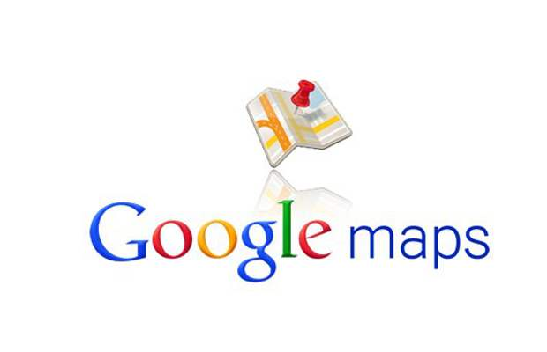
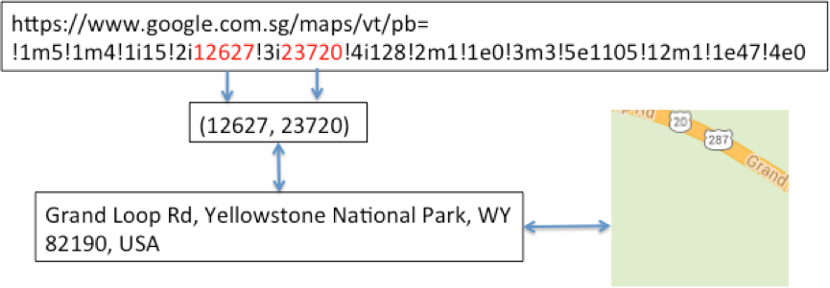
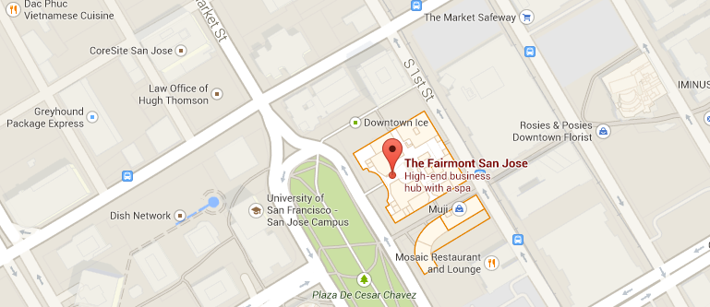
How to Infer a User’s Neighborhood?
Predictable URLs
Map
Tiles

Slide 16
Summary of Attacks & Assumption
What attacks are realistic?
Verify whether the user has been to a specific location
20 PC from 20 cities
What do we assume about the victim (e.g., Alice)?
Does not clear browser cache frequently
Visits geo-oriented sites specific to her location
Visits the malicious site
15

Slide 17
Evaluation
Questions to be answered:
(Prevalence) How many browsers and websites are susceptible to geo-inference attacks?
(Reliability) How big is the time difference between resources load time without cache and that with cache?
16

Slide 18
Evaluation Setup
Websites: 191 Google’s sites, 100 Craigslist’s sites, and 55 top Alexa sites.
Maps: Google Maps, and other 10 map service sites.
Browsers: Five mainstream browsers and TorBrowser on both desktop and available mobile platforms.
Locations: US, UK, Australia, Singapore, and Japan.

Slide 19
Websites with Location-Related Resources
All of 11 map service sites
62% of 55 top Alexa global sites

Slide 20
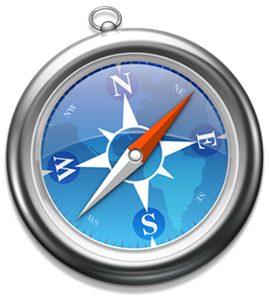
Susceptible Browsers & Platforms
Mainstream Browsers
Desktop Platforms
Mobile Platforms

Slide 21
Loading Time: Without Cache v.s. With Cache
The significant difference between the page load time (in millisecond) of 100
Craigslist sites without cache (> 1000 ms) and with cache (≈ 220 ms)
indicates geo-inference attacks with Craigslist
20

Slide 22
Discussion of Defense Solutions
Private Browsing Mode and TorBrowser
Randomizing timing measurements
Segregating browser cache
21

Slide 23
Private Browsing Mode is not the Cure
Private Browsing Mode
Clear browser cache after closing the window.
Disable disk cache, not the in- memory cache. (TorBrowser)
It cannot prevent one site from inferring the user’s geo-location from other sites
Confirmed by experiments.
Conceptionally, TorBrowser is VPN + Private Browsing Mode
Browser Cache
22

Slide 24
Randomizing Timing Measurements
Add noise into timing measurement mechanisms.
Intricate engineering effort.
Browser Cache
23

Slide 25
Segregating Browser Cache
Deploy Same-Origin Policy on browser cache. [Jackson et al. WWW’06]
We experimented in Chromium 34
High performance overhead for Alexa Top 100 websites
Browser Cache
24

Slide 26
To Cache or Not To Cache?
No cache for location-sensitive resources.
Cache-Control: no-cache HTTP response header
Open challenge to design an efficient and secure caching mechanism in browsers.
25

Slide 27
Conclusion
Geo-inference attacks via the browser cache
All five mainstream browsers and even TorBrowser, as well as 11 map service sites and 62% of 55 top Alexa websites, are susceptible to such attacks.
Discussion of existing and potential defenses.
Calling for actions

Slide 28
Yaoqi Jia E-mail: jiayaoqi@comp.nus.edu.sg

Slide 29
References
D. Akhawe, A. Barth, P. E. Lam, J. Mitchell, and D. Song, “Towards a formal foundation of web security,” in Computer Security Foundations Symposium (CSF), 2010 23rd IEEE, 2010.
A. Bortz and D. Boneh, “Exposing private information by timing web applications,” in Proceedings of the 16th international conference on World Wide Web, 2007.
G. Wondracek, T. Holz, E. Kirda, and C. Kruegel, “A practical attack to de-anonymize social network users,” in Security and Privacy (SP), 2010 IEEE Symposium on, 2010.
Z. Weinberg, E. Y. Chen, P. R. Jayaraman, and C. Jackson, “I still know what you visited last summer: Leaking browsing history via user interaction and side channel attacks,” in Security and Privacy (SP), 2011 IEEE Symposium on, 2011.
M. Jakobsson and S. Stamm, “Invasive browser sniffing and countermeasures,” in Proceedings of the 15th international conference on World Wide Web, 2006.
G. Aggarwal, E. Bursztein, C. Jackson, and D. Boneh, “An analysis of private browsing modes in modern browsers,” in Proceedings of the 19th USENIX Conference on Security, ser. USENIX Security’10, 2010.

